Slide 1
Wise Investing with R.E.T.
By Tavaris Jones, Everett Barney, Monique Ferguson, Randolph Rameau

Slide 2
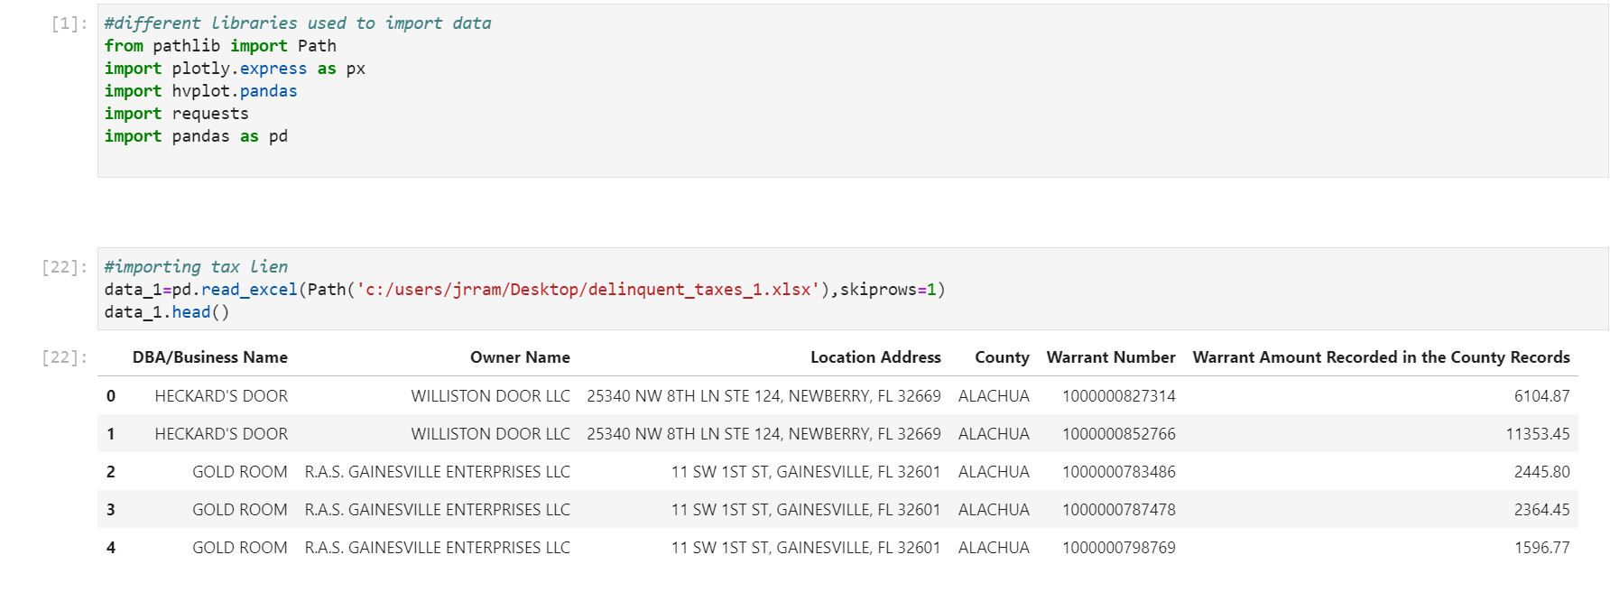
Tax Liens

Slide 3
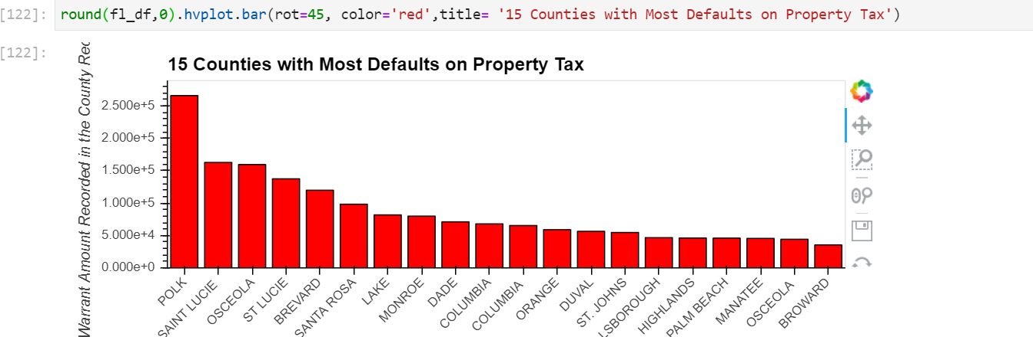
15 counties with highest tax liens on average

Slide 4
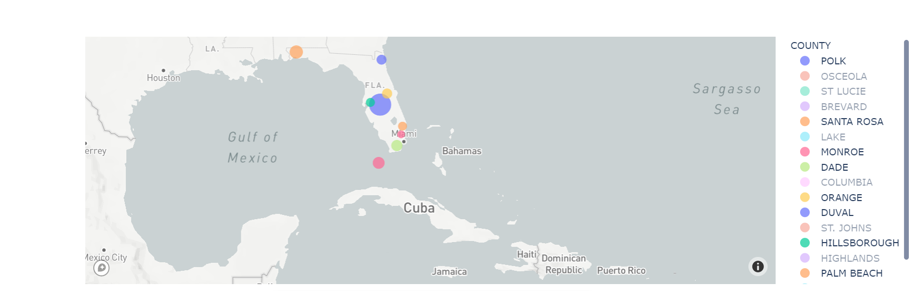
Counties displayed on Mapbox

Slide 5
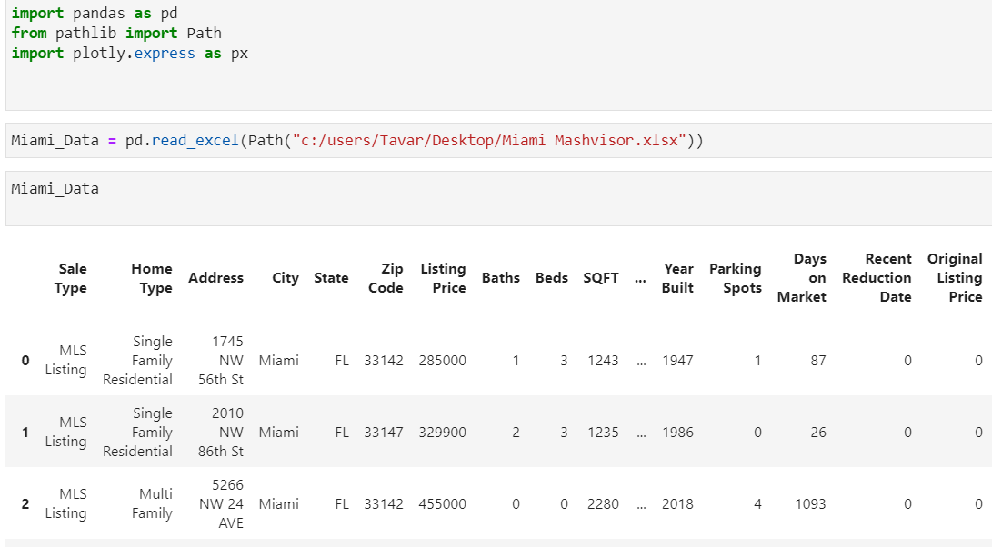
Miami Property Listings (Traditional Sale)

Slide 6
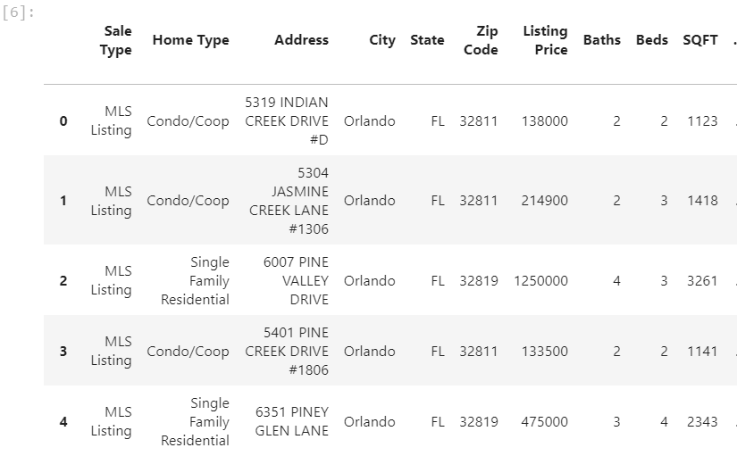
Orlando Properties Currently for Sale (Traditional Sale)

Slide 7
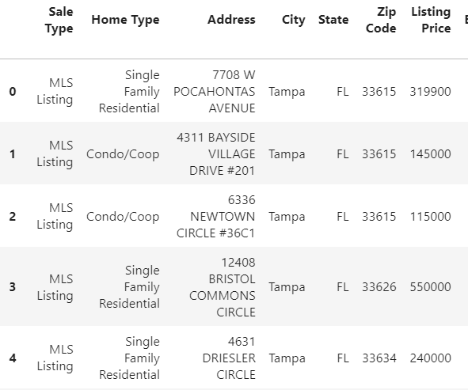
Tampa Property Listings (Traditional Sale)

Slide 8
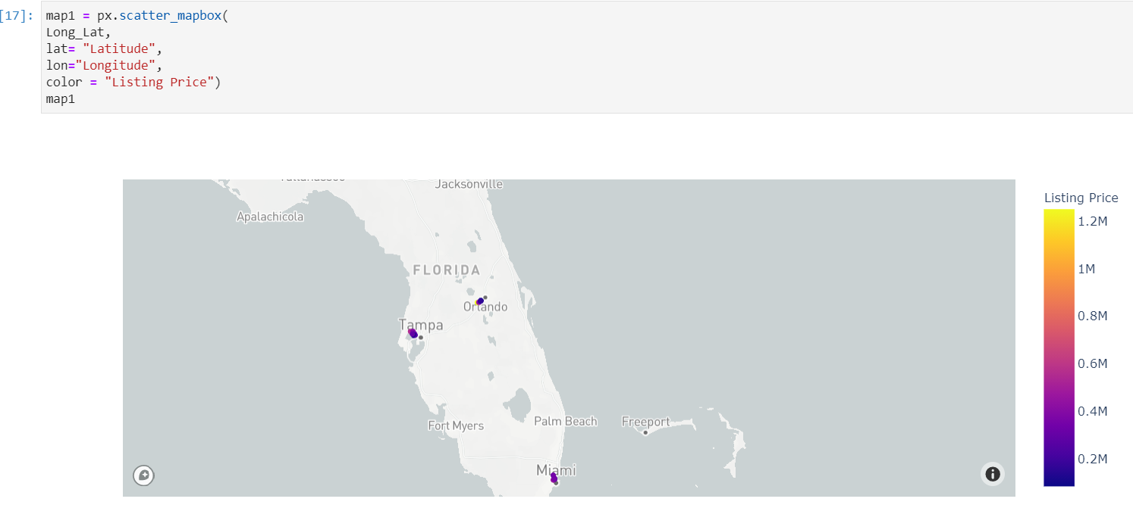
Plotted Map of listings from Miami, Orlando & Tampa

Slide 9
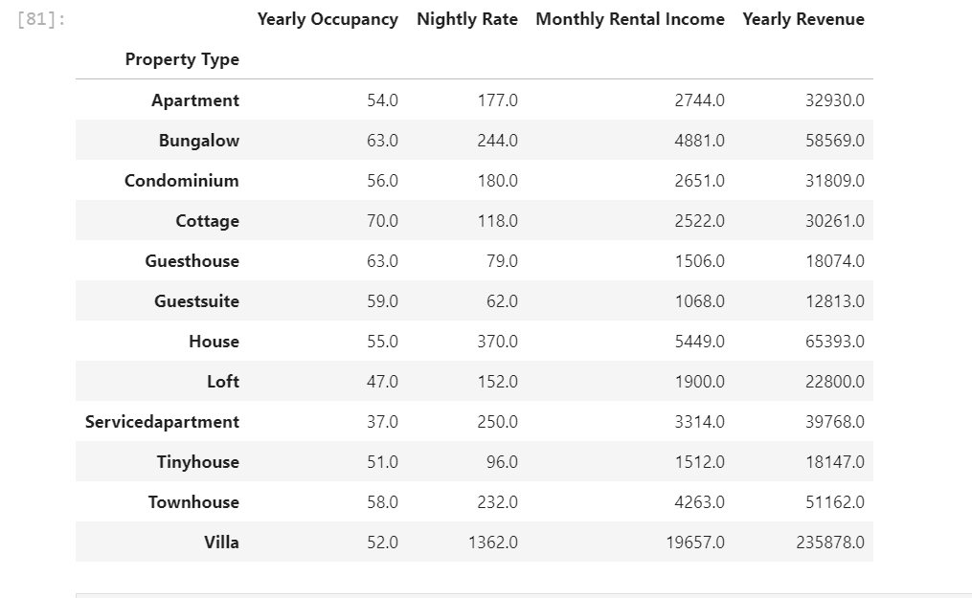
Miami - Data grouped by Property Type

Slide 10
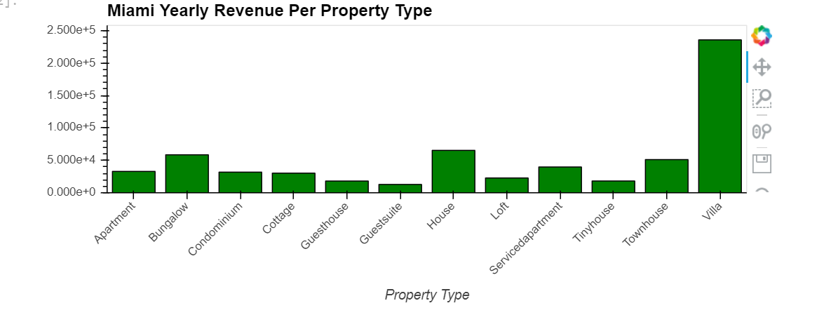
Miami - Revenue generated by property type

Slide 11
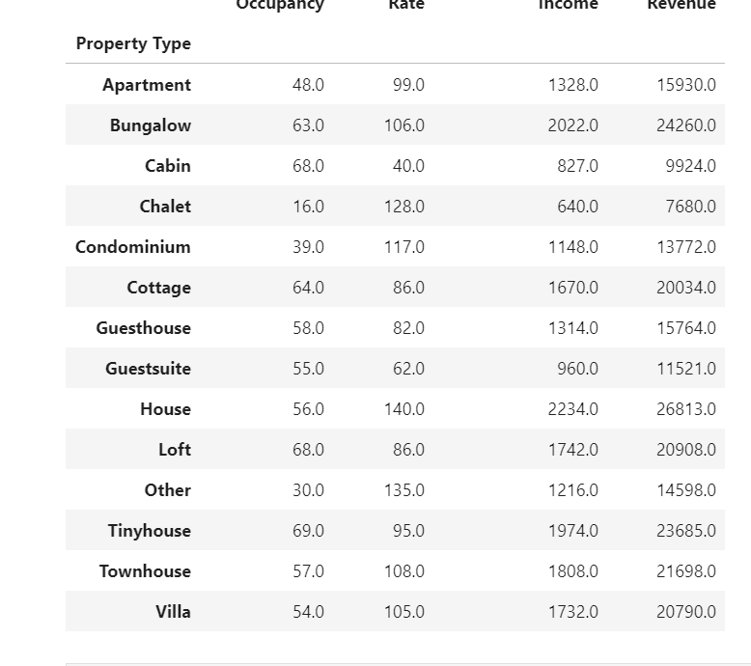
Orlando - Data grouped by Property Type

Slide 12
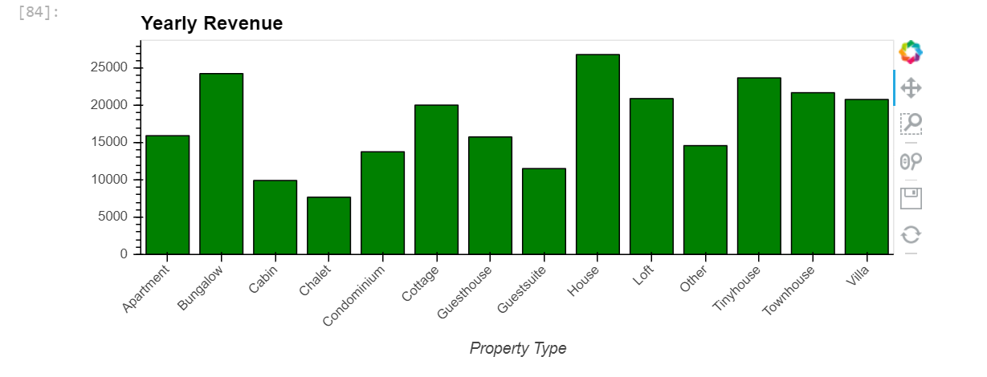
Orlando - Revenue generated by property type

Slide 13
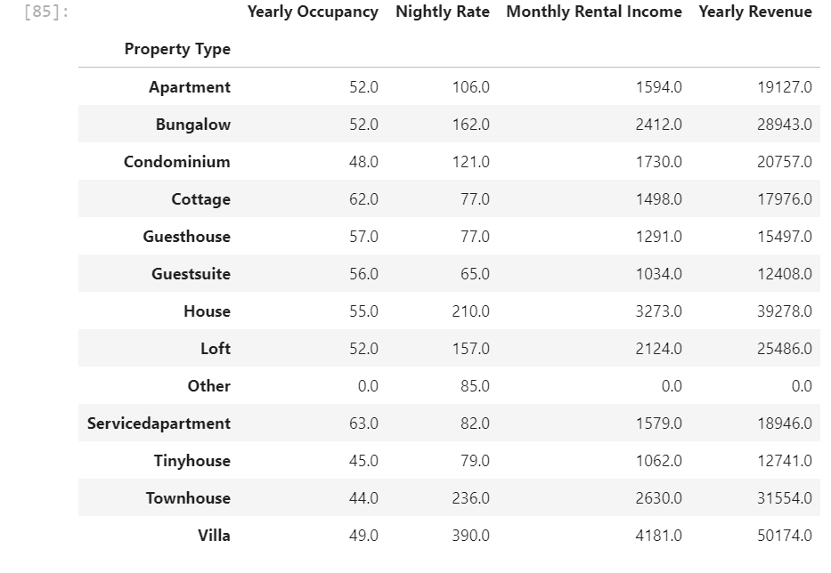
Tampa - Data grouped by property type

Slide 14
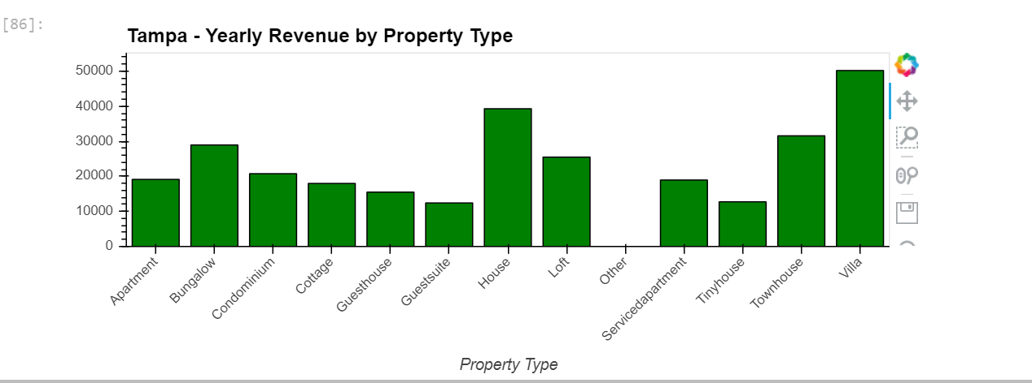
Tampa - Revenue generated by property type

Slide 15
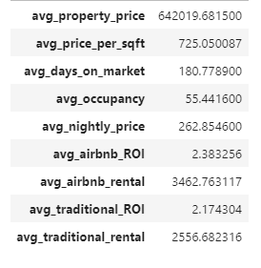
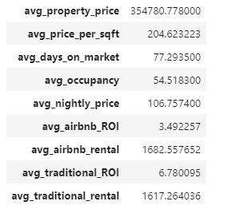
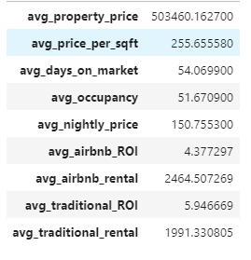
Miami, FL Orlando, FL Tampa, FL
Average cost vs ROI

Slide 16
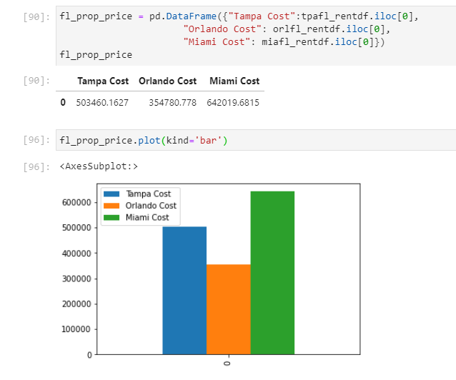
Average Property Cost in Florida Major Metropolitan Cities

Slide 17
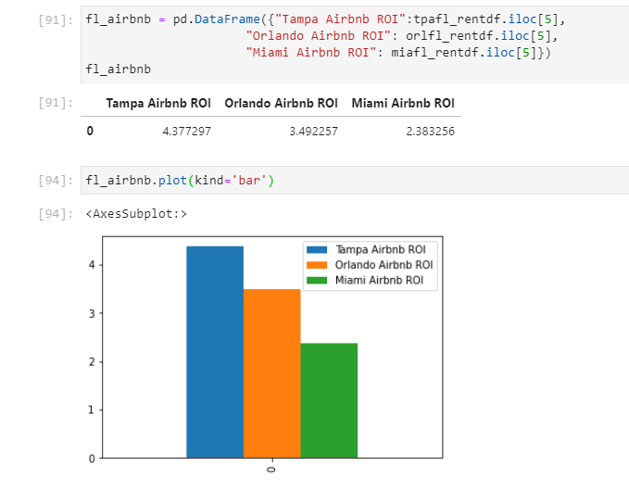
Average Airbnb Return on Investment

Slide 18
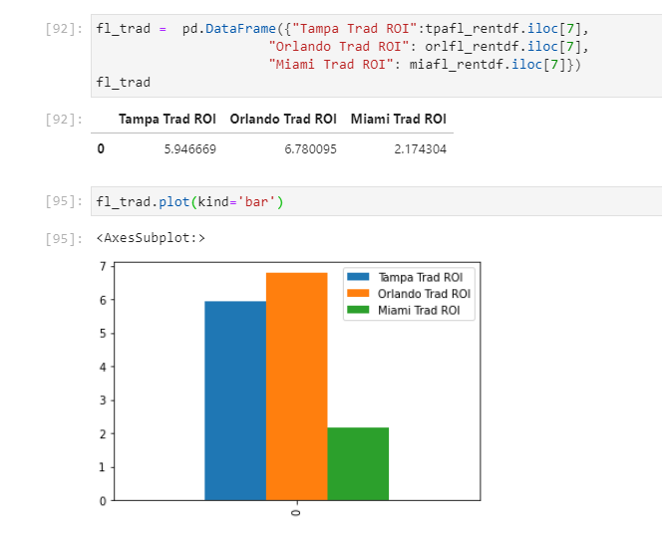
Average Return on Investment for Traditional Rentals

Slide 19
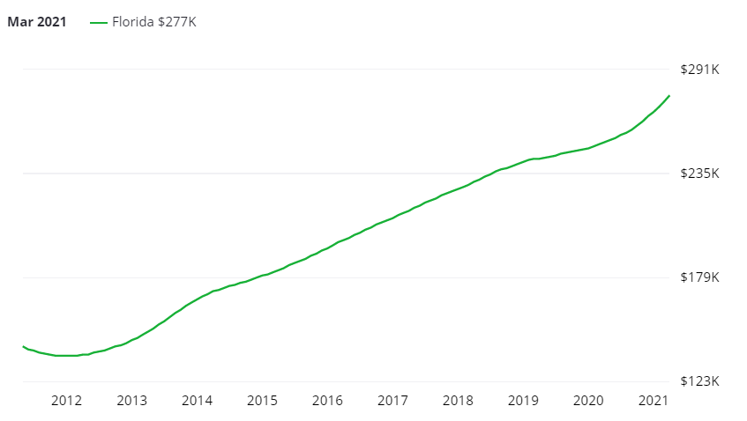
Florida Real Estate Property Value Growth

